Slide 1
Black Lane is a community school with wellbeing at the heart of everything that we do. We value the contribution everyone brings to our school which makes our school a safe, positive, friendly and caring environment. Throughout the school we strive to provide children with a range of enjoyable learning experiences which bring the curriculum to life and make learning fun through real life contexts. Everyone’s voice and wellbeing is important to us and part of our ethos. We have high expectations of all children and staff at Black Lane where everyone is supported to be the best that they can be through a stimulating and supportive learning environment.
Our vision is to:
Ensure every child feels valued and motivated to succeed in a secure and stimulating environment, where all children feel Healthy, Happy and Safe.
Have high expectations of every child, providing a wide range of enriching learning experiences that encourage and support children to reach their full potential, whatever their aspirations. This is reflected in our school motto:
“Aiming high, achieving your best!”
Trips and experiences
Pupil voice
Cymraeg
Peer learning
Challenge
Real life contexts
Collaboration
Growth mindset
Outdoor Learning
Forest School
Read, Write Inc.
Literacy
Super Learning Days
Partnership with Parents
Independence
Real PE
Happy and Fun
Inclusion
Wellbeing
Community
Numeracy
Creativity
Self-esteem
Safe
High expectations
Outdoor Learning
Digital Competence
Empathy
Jigsaw PSHE
Dreams and aspirations

Slide 2
We have core values of what we want Black Lane pupils to be:
· Happy and Healthy – this means I am resilient and I have a positive growth mindset, I look after my body and mind and I enjoy learning
· Kind and caring—this means I am respectful to others and the environment, I am polite and I treat everyone fairly
· Ambitious and Capable – this means I am confident, I aim high to reach goals and I use my imagination and thinking skills to lead my own learning and overcome challenges with independence
These are our core values and underpin everything that we do.
At Black Lane our aim is to provide an engaging curriculum that is led by children’s interests and provides them with the knowledge, skills and experiences to become confident life long learners in a fast changing world. The curriculum for wales has four purposes that aim for learners to become:
· Ambitious, capable learners ready to learn throughout their lives
· Enterprising, creative contributors, ready to play a full part in life and work
· Ethical, informed citizens of Wales and the world
· Healthy, confident individuals, ready to lead fulfilling lives as valued members of society
Happy
Kind
Healthy
Aiming high, achieving your best!
Caring
Capable
Ambitious
The four purposes and our core values underpin all aspects of curriculum design, planning and teaching and learning

Slide 3
Our Locality
Currently 24% FSM*
Semi-rural environment, but limited play areas for children
Nature areas and Brymbo Heritage are local to school
Low job opportunities/aspirations in the immediate area
The school has good ground space outside and beautiful views
The Welsh Index of Multiple Deprivation (WIMD) 2019 places Pentre Broughton is among the 50% least deprived areas in Wales overall (ranked 1049/1909). Key points include:
Income is among the 30-50% most deprived in Wales (ranked 885/1909)
Education and Community Safety is among 20-30% most deprived (ranked 486/1909; 495/1909)
Physical Environment is among the least deprived (ranked 1825/1909)
Our Staff
HT and DHT have been in post for 4 years
6 full time teachers and 1 part time teacher - teachers have been at Black Lane for many years and know the school community well
4 teachers are UPS3 and there is 1 TLR post
There are 4 full time TAs; 3 part time TAs;
New temporary appointments include: 2 apprentice TAs and 3 full time TAs supporting with accelerated learning
4 teachers have recently completed the Welsh sabbatical course and are confident speaking and teaching Welsh
Our Pupils
Approximately 137 full time pupils and 20 part time nursery+
Currently 24% FSM*
Approximately 21% accessing Targeted Universal; 1 statement, 2 ARSAP
Provision Mainly white British ethnicity; other ethnicities include: Bangladeshi, Lithuanian and Black Caribbean
Around 5.3%* of pupils have English as an additional language (EAL)
Our Classes
5 full time mixed aged classes
1 part time morning nursery class
Jigsaws (a private childcare provider) provides nursery plus provision for nursery
Early Entitlement join the nursery class in Spring and Summer terms
Classes are always below 30
We aim for a ratio of 1:10 in early years and 1:15 in upper Foundation Phase.
*data correct at time of recording (21-22)

Slide 4
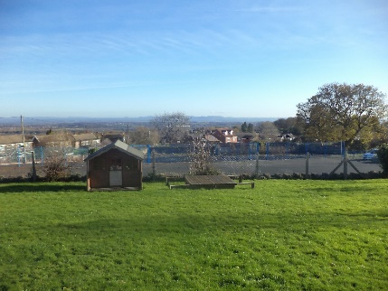
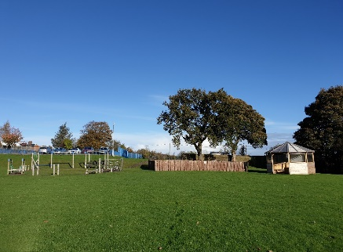
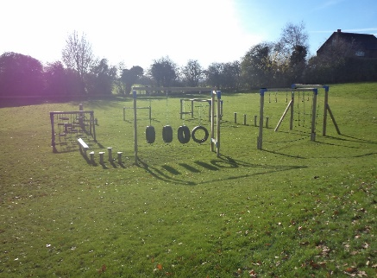
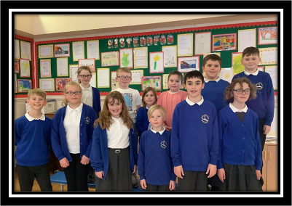
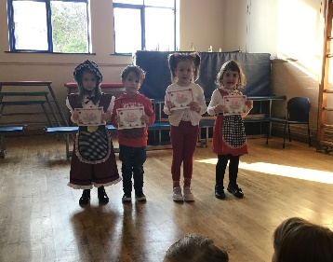
Language
Black Lane is an English-medium school with a strong focus on the Welsh language. At Black Lane we are fully committed to developing confident bilingual Welsh speakers and are working to achieve the Cymraeg Campus Language Charter. We want to inspire our children and school community to use Welsh in all aspects of their lives.
All of our teachers are confident to teach Welsh language skills across the school and are continually working hard to learn new skills. We have four full time teachers who have completed the Welsh Sabbatical course and have excellent skills to be able to develop the Welsh language to a high standard. Our vision is to deliver 10% (leading to 20%) of our curriculum through the medium of Welsh from year 2 and encourage staff and pupils to use Welsh words and phrases across different contexts.
We are proud of our Welsh ethos and we celebrate the Welsh language, culture and heritage throughout the curriculum. Topics will be enhanced with experiences to explore our locality such as visits to local nature areas including a walk up Moel Famau, museums, theatres and many more. Our learners will have the opportunity to attend residential trips to Cardiff, Nant BH and Glan Llyn.
Who are we?
Ysgol Black Lane is a primary school located in the village of Pentre Broughton, Wrexham. We provide education for approximately 155 pupils including 20 part time nursery pupils who attend during the morning sessions. Nursery pupils have the opportunity to stay all day through our onsite wrap around care provider, Jigsaws. Afterschool club is also offered to all pupils across the school.
Pupils are taught across 5 mixed aged classes and a single nursery aged class. Nearly all pupils are local to the school.
Around 24%* of pupils are entitled to free school meals which is above the Wales average of 19%
At present, around 21%* access Targeted Universal Provision to support with their learning
Most children are white British. Other ethnicities include: Lithuanian, Bangladeshi and Black Caribbean
Around 5.3%* of pupils have English as an additional language (EAL)
Our Criw Cymraeg are working to achieve the Gwobr Arian
Our annual Eisteddfod explores the Welsh language and culture
*data correct at time of recording (21-22)

Slide 5
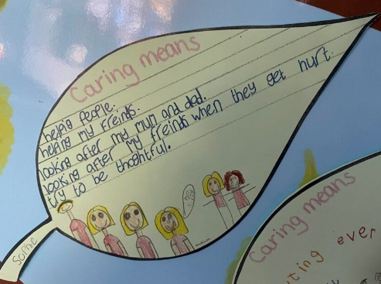
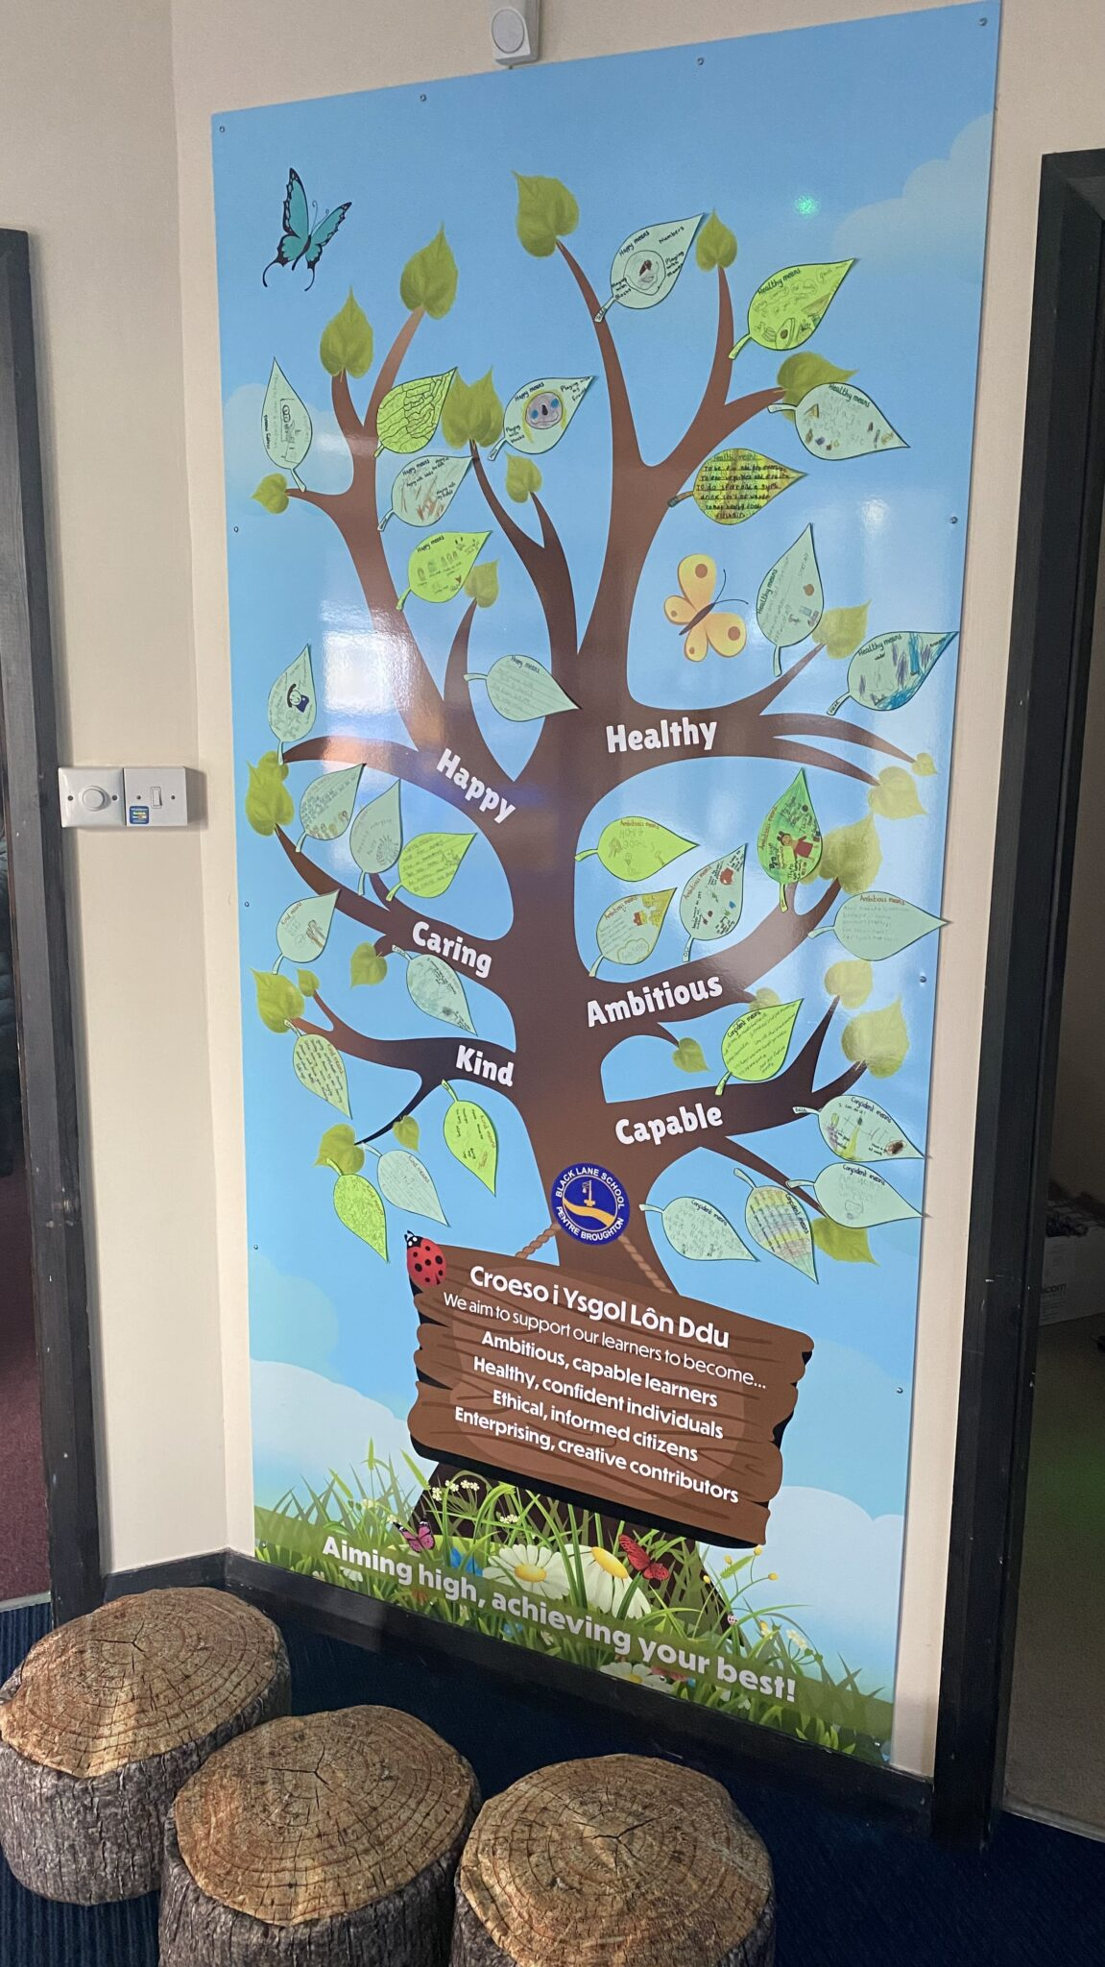
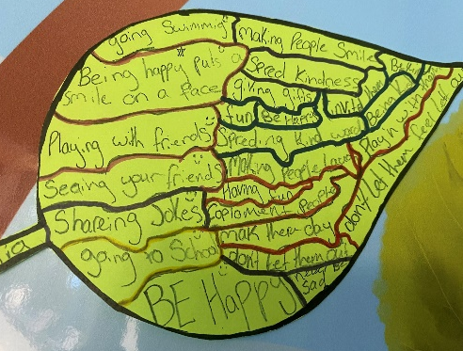
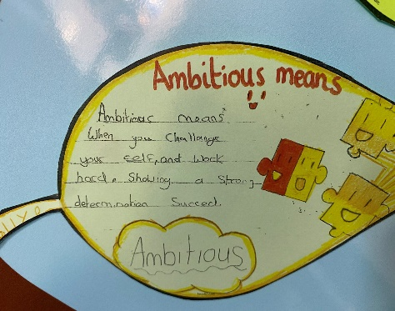
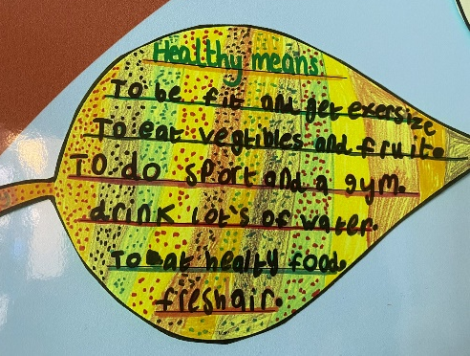
Our one page profile shows our vision, values and what is important to us. It also shows what people admire about us.
The children have explored the four purposes and the meaning of our core values

Slide 6
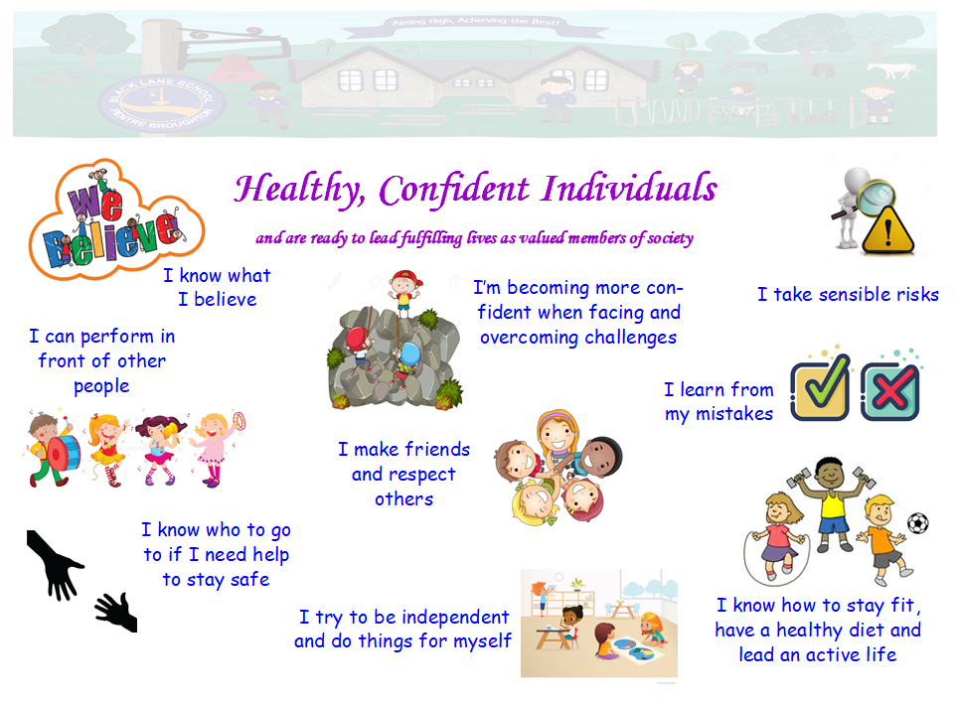
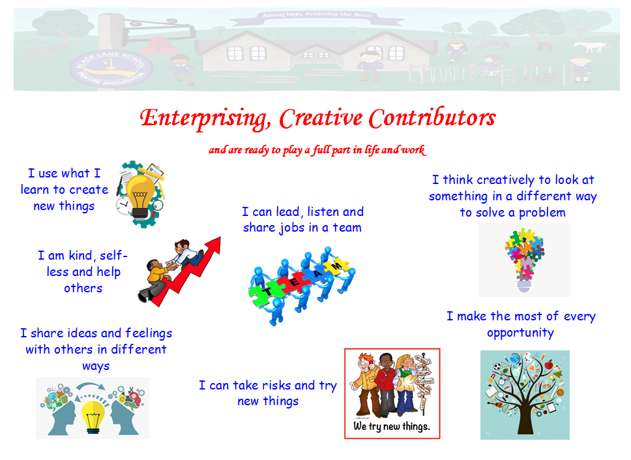
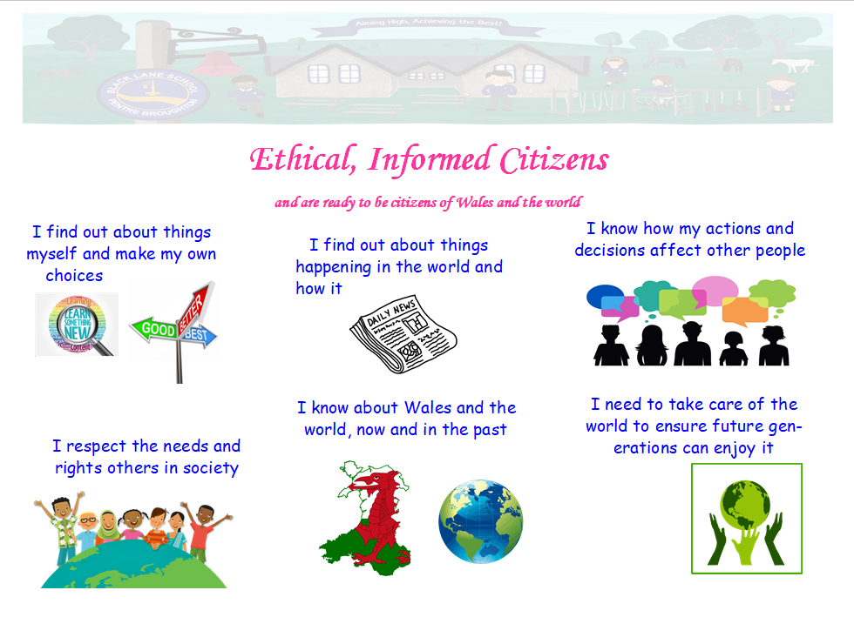
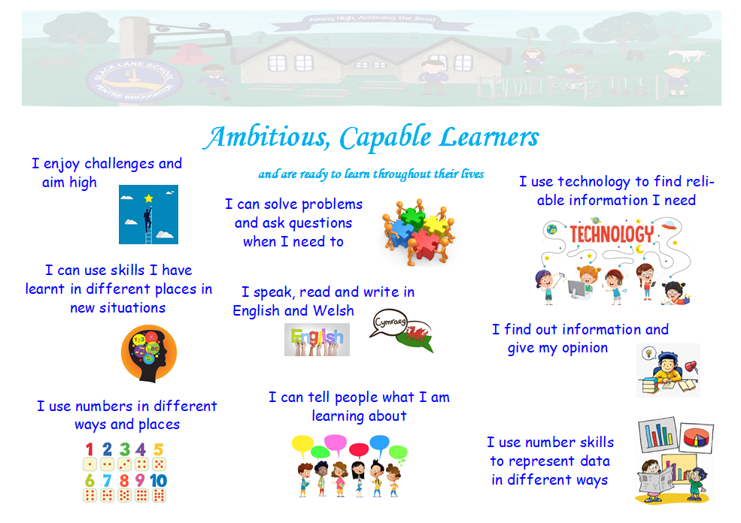
Our Curriculum
A curriculum is everything a learner experiences whilst in school – the learning experiences and the experience of learning.
Our curriculum is broad and balanced and suitable for learners of all ages, abilities and aptitudes.
Our curriculum will ensure that learners develop the skills and knowledge they need to learn successfully and achieve the four purposes – the starting point and aspiration for every child and young person in Wales.

Slide 7
The Curriculum for Wales gives us the freedom to design our own content within a national approach, enabling learners to develop towards the four purposes.
The Curriculum contains the 6 Areas of Learning and Experience and it encompasses the Statements of What Matters.
Language, Literacy and Communication
Mathematics and Numeracy
Health and Wellbeing
Children will learn about looking after their physical and mental health including emotional wellbeing. They will learn about healthy eating and how to make good decisions, deal with influences and develop healthy relationships.
Children will learn about languages. They will understand and use Welsh, English and other languages. They will study and create literature and communicate in spoken, written or visual ways. This could include poetry, drama and film.
Children will develop their understanding of numbers and use of symbols in Maths. They will explore shapes and measurement and learn about statistics and probability
Science and Technology
Children will learn about biology, chemistry, physics, computer science and design and technology. They will learn about design and engineering, living things, matter, forces and energy and how computers work.
Expressive Arts
Children will explore art, dance, drama, film and digital media and music to develop their creative, artistic and performance skills.
Humanities
Children will learn about the world, society and events in the past and present. They will explore the challenges and opportunities that face us and what ethical action we can take safeguard the world and its people in the future
We will ensure that the level of challenge is appropriate i.e. that the literacy and numeracy skills match the level of our learners' language and mathematical skills
Cross Curricular skills will be developed across all areas of the curriculum
Our teachers will plan learning experiences across the AOLEs that incorporate the cross-curricular and integral skills enabling learners to develop, practice and apply the skills fully
Literacy
Numeracy
Digital

Slide 8
We will develop the skills and concepts contained within the 27 Statements of What Matters in the AOLEs over our pupils' time at school.
These help our learners to think about what they are learning and how topics links to each other, to work and to life. When we revisit we will extend and deepen these skills and concepts to ensure progression in learning, appropriate to our learners' developmental stages
Expressive Arts | Health and Wellbeing | Humanities | Mathematics and Numeracy | Languages, Literacy and Communication | Science and Technology
Exploring the expressive arts is essential to developing artistic skills and knowledge and it enables learners to become curious and creative individuals | Developing physical health and well-being has lifelong benefits | Enquiry, exploration and investigation inspire curiosity about the world, its past, present and future | The number system is used to represent and compare relationships between numbers and quantities | Languages connect us | Being curious and searching for answers is essential to understanding and predicting phenomena
Responding and reflecting, both as artist and audience, is a fundamental part of learning in the expressive arts | How we process and respond to our experiences affects our mental health and emotional well-being | Events and human experiences are complex, and are perceived, interpreted and represented in different ways | Algebra uses symbol systems to express the structure of mathematical relationships | Understanding languages is key to understanding the world around us | Design thinking and engineering offer technical and creative ways to meet society’s needs and wants
Creating combines skills and knowledge, drawing on the senses, inspiration and imagination | Our decision-making impacts on the quality of our own lives and the lives of others | Our natural world is diverse and dynamic, influenced by processes and human actions | Geometry focuses on relationships involving shape, space and position, and measurement focuses on quantifying phenomena in the physical world | Expressing ourselves through languages is key to communication | The world around us is full of living things which depend on each other for survival
 | How we engage with social influences shapes who we are, and affects our health and well-being | Human societies are complex and diverse, and shaped by human actions and beliefs | Statistics represent data, probability models chance, and both support informed inferences and decisions | Literature fires imagination and inspires creativity | Matter and the way it behaves defines our universe and shapes our lives
 | Healthy relationships are fundamental to our well-being | Informed, self-aware citizens engage with the challenges and opportunities that face humanity, and are able to take considered and ethical action |  |  | Forces and energy provide a foundation for understanding our universe
 |  |  |  |  | Computation is the foundation for our digital world

Slide 9
‘Our curriculum develops and embeds the mandatory cross curricular skills and Integral skills across the areas of learning’
We ensure that we plan for integral skills to be developed across a wide range of teaching and learning, which underpin the four purposes. These are:
Cross Curricular skills will be developed across all areas of the curriculum
Literacy
Numeracy
Digital
Four Purposes
Creativity and Innovation
Curious and inquisitive
Link and connect knowledge, experiences and skills
Explore and justify ideas
Critical Thinking and Problem Solving
Ask questions, evaluate, analyse, justify, make decisions and find solutions
Personal Effectiveness
Emotional intelligence, confident and independent
Evaluate and identify areas for development
Discuss and consider social, ethical, cultural and legal implications
Planning and Organisation
Planning and Organisation
Set goals and make decisions
Reflect, adapt and manage, time, people and resources
Literacy, numeracy and digital competence are essential for learners to be able to access knowledge.
Our curriculum develops and embeds these cross curricular skills across the areas of learning, providing opportunities to extend and apply across the areas of learning. These are skills that can be transferred to the world of work, enabling learners to adapt and thrive in the modern world.
Our learners will be given opportunities to:
develop listening, reading, speaking and writing skills
be able to use numbers and solve problems in real-life situations
be confident users of a range of technologies to help them function and communicate effectively and make sense of the world
Cross Cutting themes will also be planned across the curriculum
Relationship and sexual education (RSE)
Human Rights
Diversity
Careers and work related experiences
Local, national and international contexts

Slide 10
What Teaching Looks like in our School
Identify pupils’ needs
Match these needs to the most appropriate pedagogical approach
Assess approach through pupil progress
Excellent teaching is essential in working towards the four purposes, our vision and the curriculum framework. We will use a range of pedagogical styles choosing these approaches thoughtfully in the context of curriculum purposes and the needs and developmental stage of learners across the 3-16 continuum.
We will ensure that the curriculum draws on the voice of our learners and responds to their needs, experiences and input into their learning
Create authentic contexts for learning
Encourage learners to take responsibility for their own learning
Encourage collaboration
Support social and emotional development & positive relationships
We plan for rich, authentic learning experiences that challenge and motivate the individual needs of the school and learners.
Sustained pupil effort to reach high but achievable targets
Employing a broad repertoire of teaching approaches
Promote problem solving, creative & critical thinking
Build on previous knowledge & experience to engage interest
We will work together to ensure a continuum of learning between phases to ensure appropriate continuity of learning and teaching
Focus on the 4 purposes
Use assessment for learning to accelerate progress
Make connections within & across Areas of Learning & Experience
Reinforce Cross Curricular responsibilities - Literacy, Numeracy & Digital Competence
Staff support learners to identify their greatest areas of need and match this with the most appropriate teaching approach. The 12 pedagogical principles are not intended as a checklist but to underpin the implementation of the curriculum.

Slide 11
Assessment
‘Assessment plays a fundamental role in enabling each individual learner to make progress at an appropriate pace, ensuring they are challenged appropriately.’
Assessment is part of learning every day. We work with our learners to identify strengths, areas for development and inform next steps in teaching and learning. We use a range of assessment strategies to support the progression of each individual learner. The pace at which learners progress will be individual to each learner. Assessment has three purposes:
Support individual learners on a day to day basis
Focuses on learner strength and areas for improvement. Where relevant barriers to learning
Engages the learner and helps to move learning forward day to day
Identify, capture and reflect on individual learner progress over time
Identifying and reflecting on progress of individual learners over time.
Provide feedback to help plan future learning including additional support or challenge
Understand group progress in order to reflect on practice
Identifies progress of different groups of learners
Used to ensure the curriculum and the teaching and learning helps raise achievement for all
We communicate effectively with parents/carers on an ongoing basis to foster positive relationships in order to engage them in purposeful and meaningful dialogue. When undertaken well, this can help aid learner progression by helping parents/carers to understand how they can support learning within and outside the school environment.
We have developed and implemented processes which support effective two-way communication and engagement with parents/carers. When developing these processes, consideration has been given to using a wide variety of different communication means, e.g. face-to-face, Class Dojo, Seesaw and email.
Information on any support, interventions or additional needs required for the learner’s development is shared with parents and carers.

Slide 12
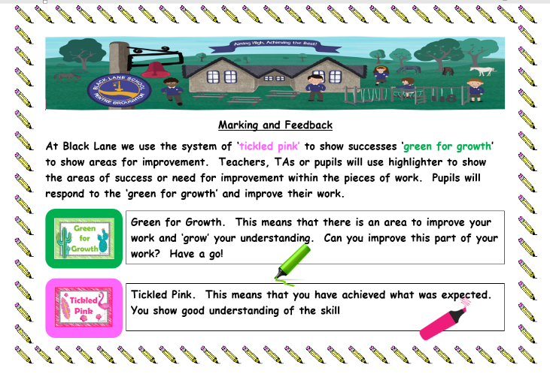
Progression
‘Supporting learners to make progress is our fundamental driver’
Our curriculum, supported with effective teaching and learning enables learners to make meaningful progress. Progression in learning is a process of developing and improving skills and knowledge over time. We use the Descriptions of Learning within each what matters statement to assess and plan for learners’ progress. These are arranged in 5 progression steps. These broadly correspond to expectations at ages 5, 8, 11, 14 and 16 years.
Progression Step 1
Progression Step 2
Progression Step 3
Progression Step 4
Progression Step 5
Opportunities for ongoing reflection and assessment are sought throughout teaching and learning experiences. The assessment process is continuous and pupil centred. Each individual child is on their own unique journey.
We realise the importance of instant feedback and use a range of ‘Assessment for Learning’ strategies to support pupil progress, rather than marking at the end of the lesson or school day. We make use of verbal feedback, pit-stops, talking partners, WAGOLLs, working walls, Apple TV, peer and self assessment. We make use of ‘listening to learners’ to ensure that they can talk about their work, can show understanding and are aware of next steps and targets for improvement.
We also use the Principles of Progression underpin our planning for pupil progress over time in our planning for pupil progress over time
Increasing effectiveness
Increasing breadth and depth of knowledge
Deepening understanding of the ideas and disciplines within the areas
Refinement and sophistication in the use of application of skills
Making connections and transferring learning into new contexts
Example of pupils work
At Black Lane we aim for every child to success…’aiming high, achieving your best’!

Slide 13
We use a range of Assessment for Learning (AfL) strategies which supports assessment of individual learners on a day to day basis and contribute towards the realisation of the whole curriculum
Formative Assessment Strategy | Four Purposes | Integral skills | 12 Pedagogical Principles
Learning climate and culture, Growth Mindset, Learning powers, Learning zones celebrate mistakes, embrace challenge | Ambitious, capable learners Healthy, confident individuals Enterprising, creative contributors | Creativity and innovation Personal Effectiveness Planning and organising Critical thinking and problem solving | 1,2,3 7, 10,11, 12
Involvement of learners in the planning | Ambitious, capable learners Individuals healthy, confident Contributors enterprising, creative | creativity and innovation Personal Effectiveness Planning and Organise Critical thinking and problem solving | 1,2,3 7, 10,11, 12
Talk partners | Ambitious, capable learners Healthy, confident individuals Enterprising, creative contributors | Personal Effectiveness Planning and Organising Critical thinking and problem solving | 1,2,3,4 7, 10,11, 12
Learning intentions and Success Criteria | Ambitious, capable learners | Personal Effectiveness Planning and Organising | 2,3,4,5,7, 10, 11,12
Feedback -Verbal , Peer and Written | Ambitious, capable learners Healthy, confident individuals Enterprising, creative contributors | Personal Effectiveness Planning and Organizing Critical thinking and problem solving | 1,2,3,4, 7, 10,11, 12
Prior/ Current knowledge Questioning | Ambitious, capable learners Healthy, confident individuals Enterprising, creative contributors | Personal Effectiveness Planning and Organising Critical thinking and problem solving | 1,2,3,4,5,7,10 11, 12
Differentiated challenges and eliminatiing ability groups | Ambitious, capable learners Healthy, confident individuals | Personal Effectiveness Planning and Organising Critical Thinking and Problem Solving | 1,2,3,5,7,10 11, 12

Slide 14
Assessment Overview
At Black Lane we use assessment to continually assessing learners progress rather than making one off judgements. We use assessment to reflect learners’ progression that is individual to them. We use a range of assessment methods, to develop a holistic picture of the learner – their strengths, areas for improvement and the support and challenge needed to take their learning forward.
We use a range of evidence to inform assessment and progression:
Observation
Listening to learners
Books
Learning walks
Incerts/Taith360
Seesaw
Google Classroom
Oxford Reading Buddy
Wordshark
Read, Write Inc
Pupil progress meetings
Professional dialogue meetings

Slide 15
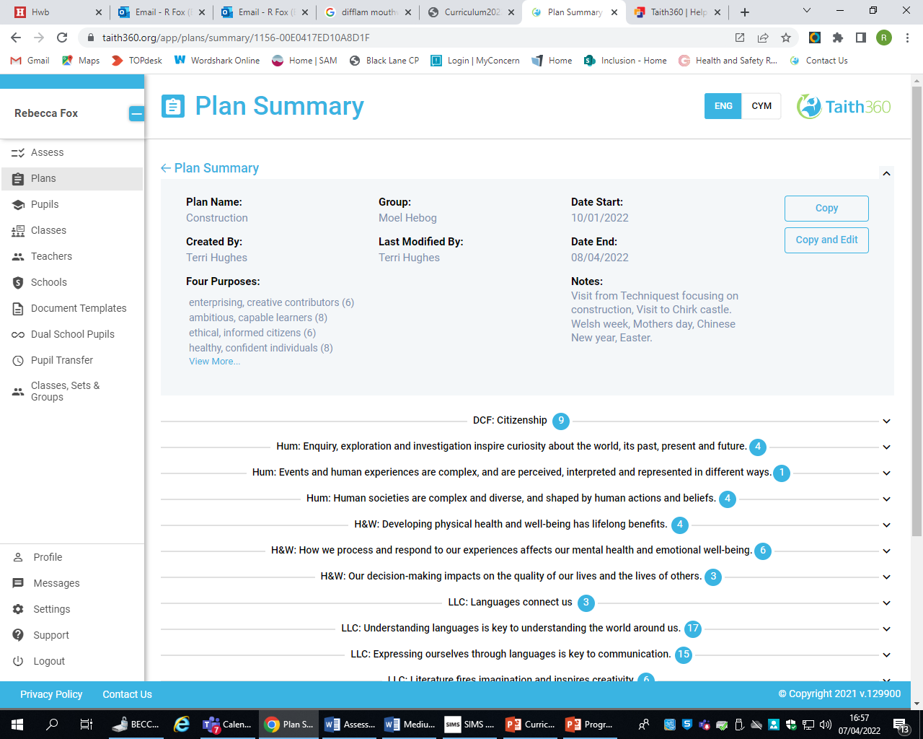
Examples
At Black Lane we are currently using and trialling Taith360 to plan topics that include description of learning from across the what matters statements within each area of learning, as well as the cross curricular skills. Teachers also include planning for the four purposes within each topic plan. This planning tool enables teachers to track coverage across the curriculum.
Teachers can use Taith360 to assess individual and groups of pupils in all areas of learning and the cross curricular skills over time. Each learners progress is tracked from progression step 1 to 5. Teachers will add notes and/or evidence to show how and what the child have achieved. Teachers will also assess wellbeing and attitudes to learning to ensure the curriculum is relevant and pupils are supported with needs.
Numbers next to each WMS and Four Purposes show how many times it has been covered. Teachers use this to inform future planning

Slide 16
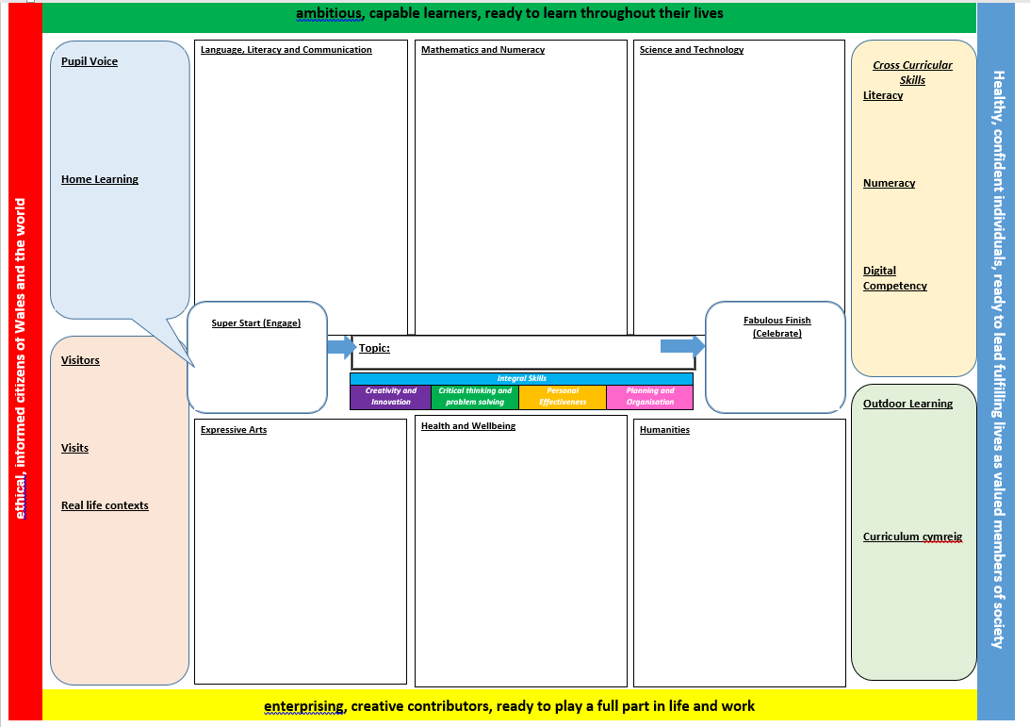
More examples…
We are trialling a medium term topic planner to develop connections between the AoLEs. We want to plan for excellent teaching and learning, so we have included opportunities to plan for the pedagogical approaches.
Each topic will include a learning experience (a Super Start) which will engage learners, spur curiosity and make learning real. We will enhance our curriculum with a variety of enrichment experiences.
We celebrate all learning. We aim to ensure that all learning has a purpose and learners work towards a ‘Fabulous Finish’. For example this could be presenting to an audience, making an Imovie or organising an event.
Our children choose the topics for their year. We have lead and supporting AoLEs.
We also plan for discrete learning to ensure coverage of knowledge, skills and experience.
Staff develop/share WALTs and Success Criteria with the learners for each lesson, so that they understand what they learning, how they can achieve and how to improve their work. We provide immediate feedback so that children can reflect and improve their work.
In Foundation Phase (FP) staff develop high quality learning environments to support learning through play. Staff plan for skills within the continuous provision areas and adults facilitate learning. As pupils progress through FP they complete challenges in the areas, developing independence, problem solving skills and resilience.
Need examples of fully completed medium term plans

